Slide 1
THE BATTLE OF NEIGHBORHOODS
IBM CAPSTONE PROJECT

Slide 2
INTRODUCTION
Many people migrate to Canada every year for better opportunities
This project is done to analyze the features of neighborhoods for people migrating to Scarborough district in Toronto, Canada
The features analyzed are the average housing prices per neighborhood and the ratings of schools per neighborhood

Slide 3
DATA DESCRIPTION
Data Link: https://en.wikipedia.org/wiki/List_of_postal_codes_of_Canada:_M
Dataset consists of latitudes, longitudes and zip codes
Foursquare API is used to gather information on different venues in different neighborhoods

Slide 4
METHODOLOGY
Neighborhoods are explored, segmented and grouped into clusters
For the purpose of clustering, k-means algorithm is used
With the results obtained, a suitable neighborhood may be selected

Slide 5
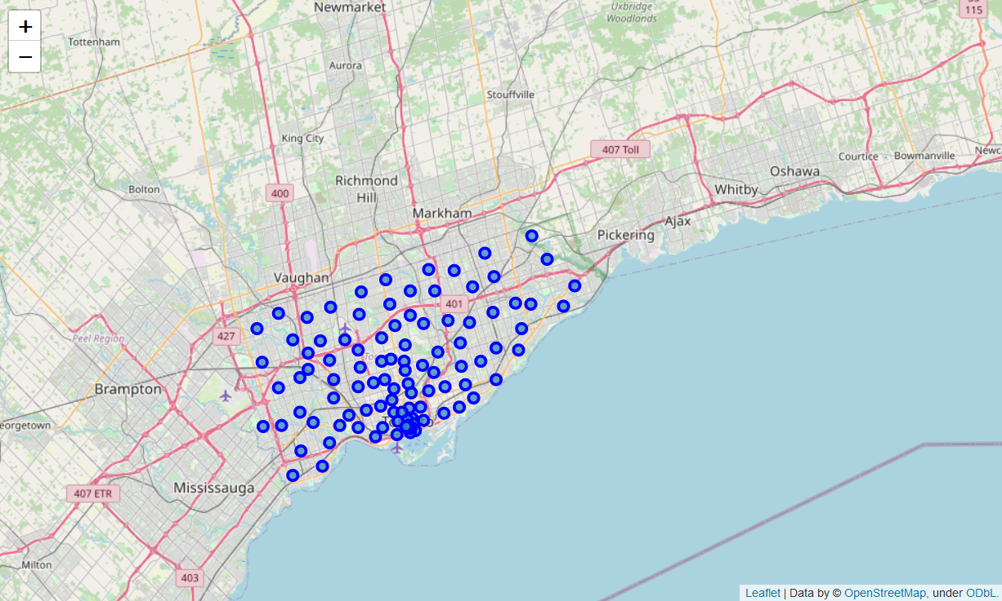
RESULTS: CLUSTER MAP

Slide 6
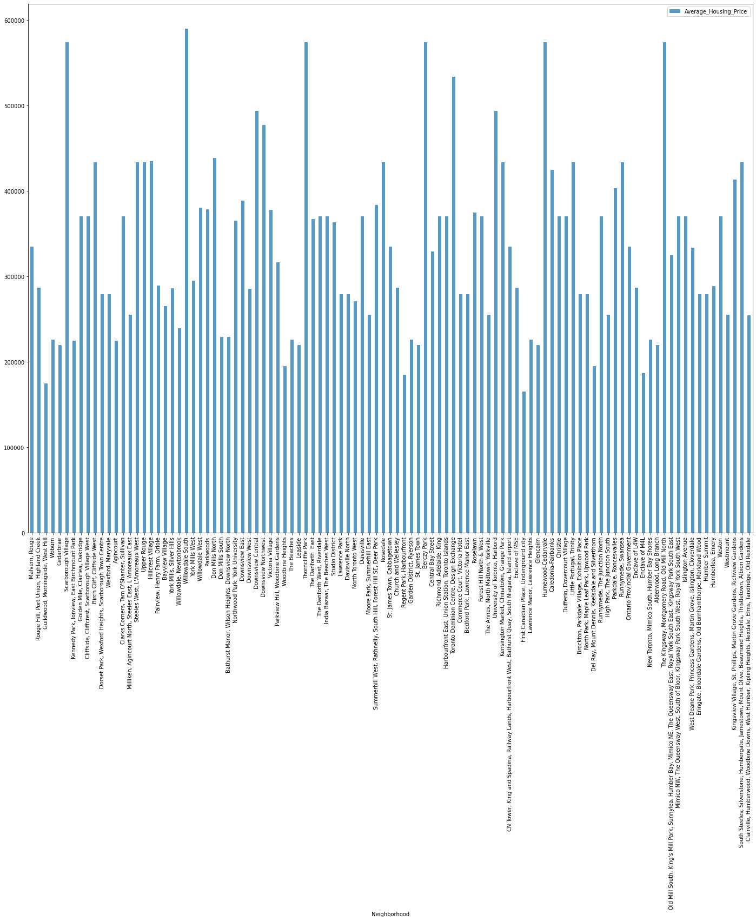
RESULTS: AVG. HOUSING PRICES

Slide 7
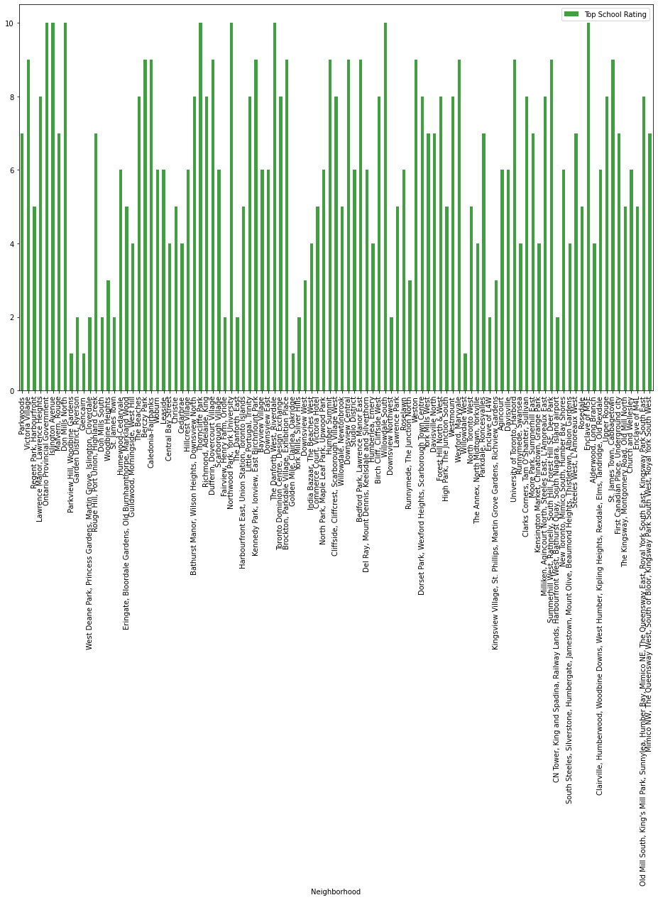
RESULTS: SCHOOL RATINGS

Slide 8
DISCUSSION AND CONCLUSION
For a couple with young children who can afford the housing prices of Malvern Rouge will prefer this neighborhood because of top schools
On the other hand, a couple with grown up children wouldn’t mind moving to Woodbine Gardens
Using the graphs of average housing prices and ratings of schools, a migrant will be able to select an appropriate neighborhood tailor to his/her needs.

